Slide 1
Bug Localization with Combination of Deep Learning and Information Retrieval
A. N. Lam et al. International Conference on Program Comprehension 2017 Presentor : Jee-weon Jung, 18. 05. 11.

Slide 2
Index
Overview
Introduction
Background
Model architecture
Feature extraction
Feature reduction with autoencoder
DNN-based relevancy estimation
Empirical evaluation
Conclusion

Slide 3
Overview
Object : bug localization
Bug localization : locating potential buggy files using a given bug report
Lexical mismatch is a key challenge in bug localization
Terms in bug reports does not match the terms in src codes
Propose DNN + rVSM(information retrieval) approach
DNN : used for relating terms in bug reports with terms in src files
rVSM : collects the feature on the textual similarity between bug reports and src files
rVSM and DNN complement each other in real world evaluation
50% precise bug localization with single suggested file
66% in 3-best suggestion

Slide 4
Introduction (1)
Software maintainance (bug fixing) is time consuming
Developers investigate and locate potential buggy files using bug reports
Bug reports : description on the scenario when the softwave malfunctions + may provide relevant information as well
Quickly & precisely locating bug files are crucial to efficiency

Slide 5
Introduction (2)
Two main categories of works exist to assist bug localization
Falut localization : statisics of program analysis information / focus on the program’s semantics and execution
Analyze contents of the bug report : use information retrieval methods such as Latent Dirichlet Allocation / Latent Semantic Indexing / probabilistic ranking / Vector space model, etc.
Machine learning is used for bug localization recently
Use previously fixed files as classification labels and assign each report
Cannot suggest files that have not been fixed before

Slide 6
Introduction (3)
This paper develop DNNLOC (DNN + rVSM)
rVSM : extract features to measure similarity using texts
DNN : measure the relevancy (=similarity) between bug report and src code
DNN is also used to combine DNN, rVSM, Metadats’s output
>>> Deal the lexical gap with DNN and use rVSM as feature extractor
Autoencoder is used to make DNNLOC scalable
Reduce the dimensionality of data
Meta feature is additionaly extracted and used
Human’s knowledge into DNN
Ex) recently fixed files are more likely buggy files

Slide 7
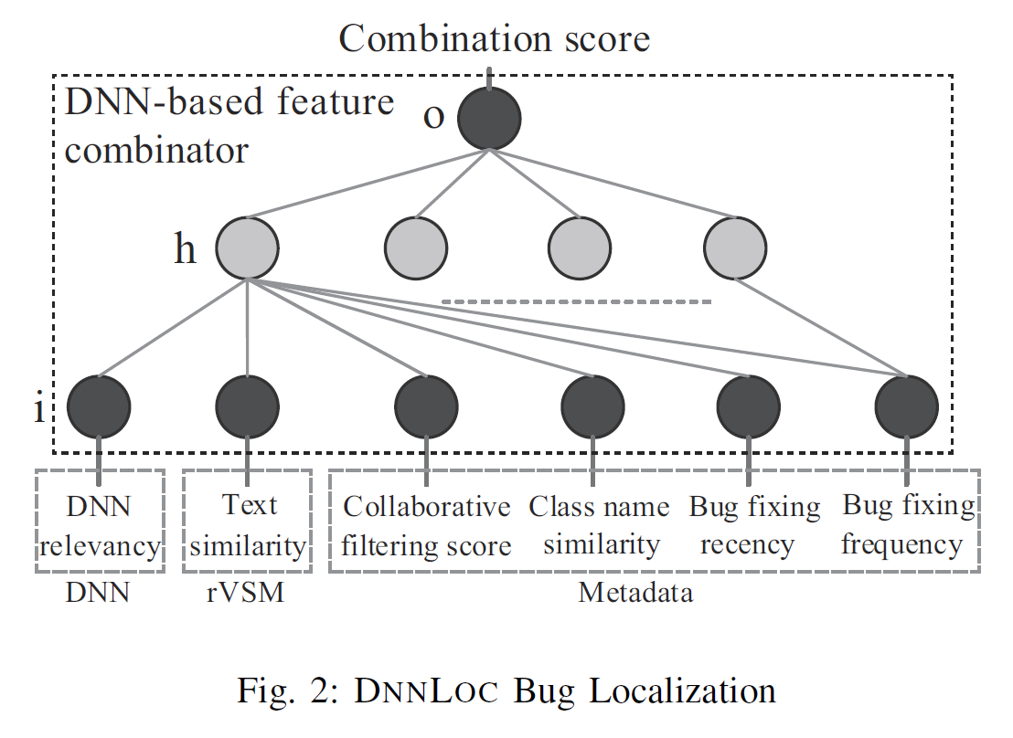
Introduction (4)

Slide 8
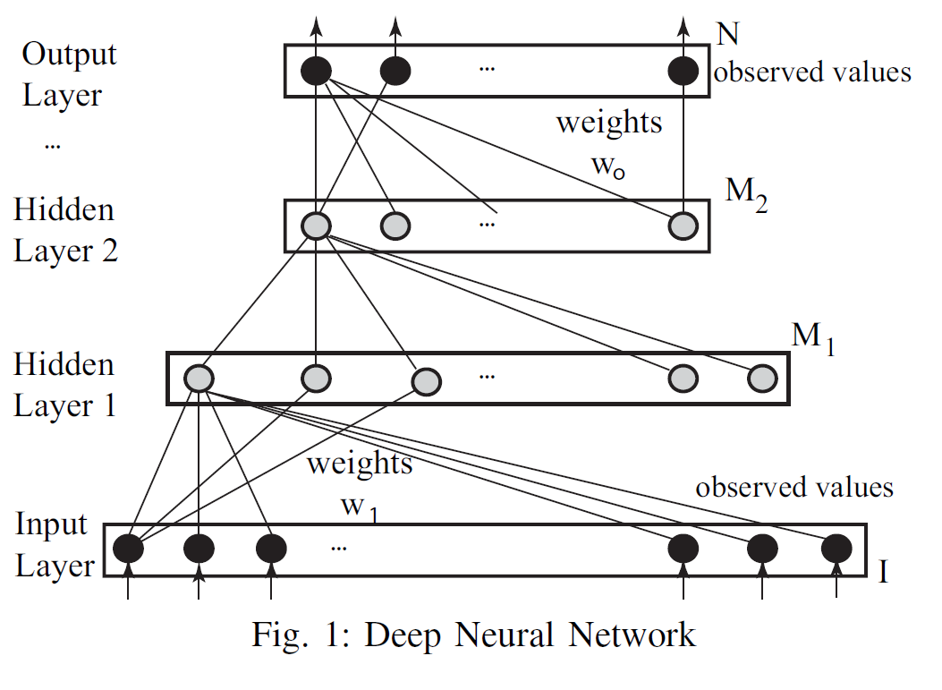
Background (1)
DNN models complex nonlinear relationships
Power comes from nonlinear activation functions, deep architecture
This paper uses primitive type of DNN, a multi-layer perceptron

Slide 9
Model architecture (1)
Generate positive / negative pair between a bug report and buggy file
Model architecture flow
Feature extraction → reduce dimensionality using DNN (autoencoder) → parallelly processed features are all fed into DNN (MLP, combiner) → output score is used as confidence score
To compute the relevancy between a bug report and a file, text tokens are extracted
Identifiers, API method, classes, comments, textual descriptions of API

Slide 10
Model architecture (2)
Combiner DNN combines DNN(autoencoder’s output) relevancy, rVSM textual similarity, and meta data
Inputs one bug report and one buggy / non-buggy file → outputs confidence score

Slide 11
Feature extraction (1)
Parse bug report into words using whitespace
‘a’, ‘the’, punctuations removed
Compund word decomposed using capital letter
“childAdded” → child, added
Term frequency-inverse document frequency is used to measure term significance weights of all words
For src file, 4 types of features are extracted
2 code based / 2 textual
Names, identifiers / names of API classes and interfaces (code based)
Apply same mechanism to the comments and string literals in the src code

Slide 12
Feature extraction (2)
4 types of meta data from bug-fixing history of a project
How recent a file has been fixed (several studies used this data)
Measured in months
Bug fixing frequency
collaborative filtering score : measure the similarity of a bug report and previously fixed bug reports by the same file (proposed in another paper)
Textual similarity between names of classes in a bug report and src file

Slide 13
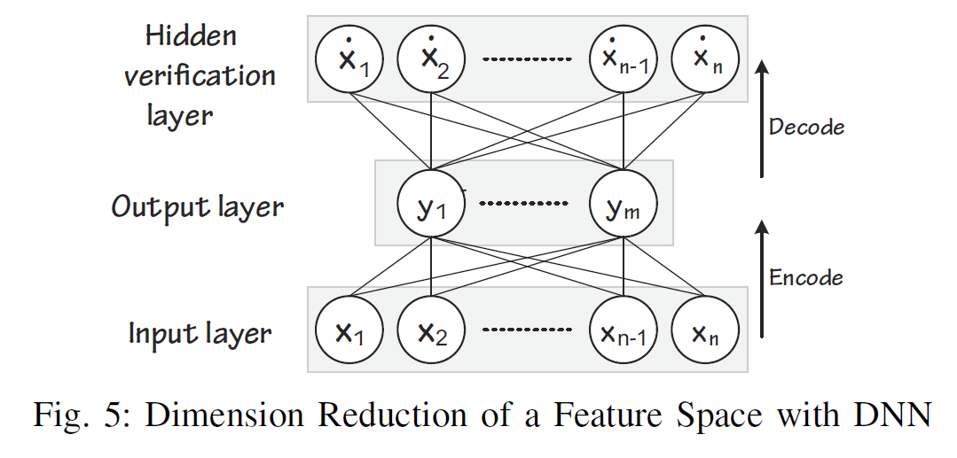
Feature reduction with autoencoder (1)
For processing real-world data, reducing the dimensionality is crucial
Reduce computational cost for deep learning
Use autoencoder which has three layers
Target output = input

Slide 14
Feature reduction with autoencoder (2)
Adoptation of autoencoder brings differentiation with LSI
LSI cannot scale for a large matrix
LSI conducts linear transformation
Nonlinear transformation appears to be more resilient to noises and various input data types

Slide 15
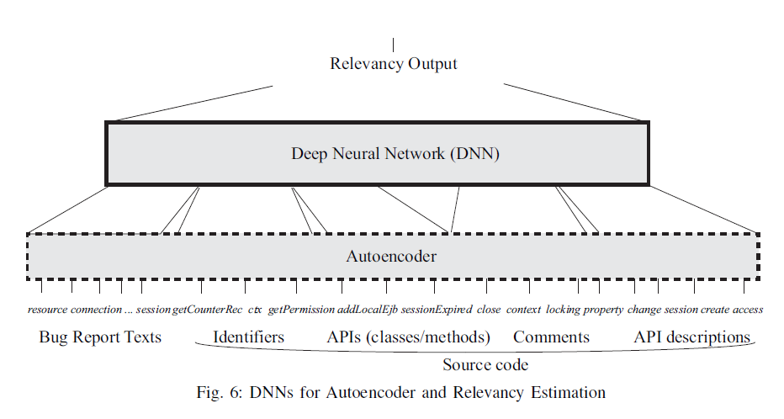
DNN based relevancy estimation (1)

Slide 16
DNN based relevancy estimation (2)
In relevancy estimator DNN, autoencoder DNN, combiner DNN, fully connected (dense) layers are used
Feature selection is conducted using DNN
When training, output relevancy score is either 0 or 1
At prediction, score between 0 and 1 is obtained

Slide 17
DNN based relevancy estimation (2)
In relevancy estimator DNN, autoencoder DNN, combiner DNN, fully connected (dense) layers are used
Feature selection is conducted using DNN
When training, output relevancy score is either 0 or 1
At prediction, score between 0 and 1 is obtained

Slide 18
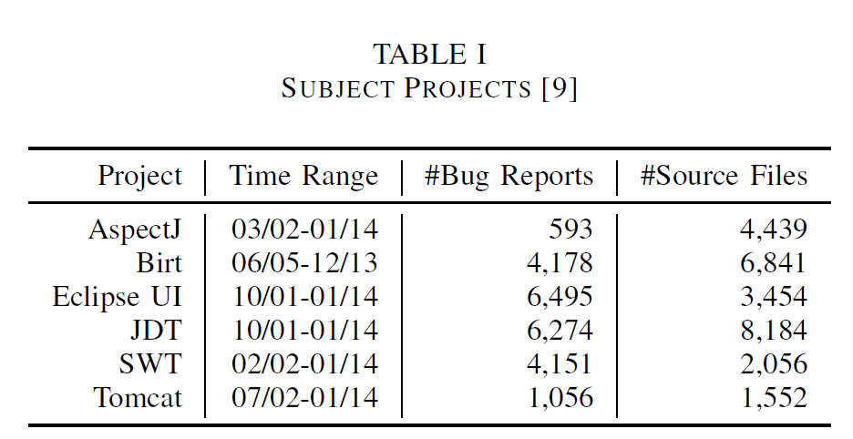
Empirical evaluation (1)
Evaluated proposed system’s accuracy /compare with existing information retrieval and machine learning approaches / time efficiency / impact of parameters, components, features /
Dataset : same with Ye et al.(cited)

Slide 19
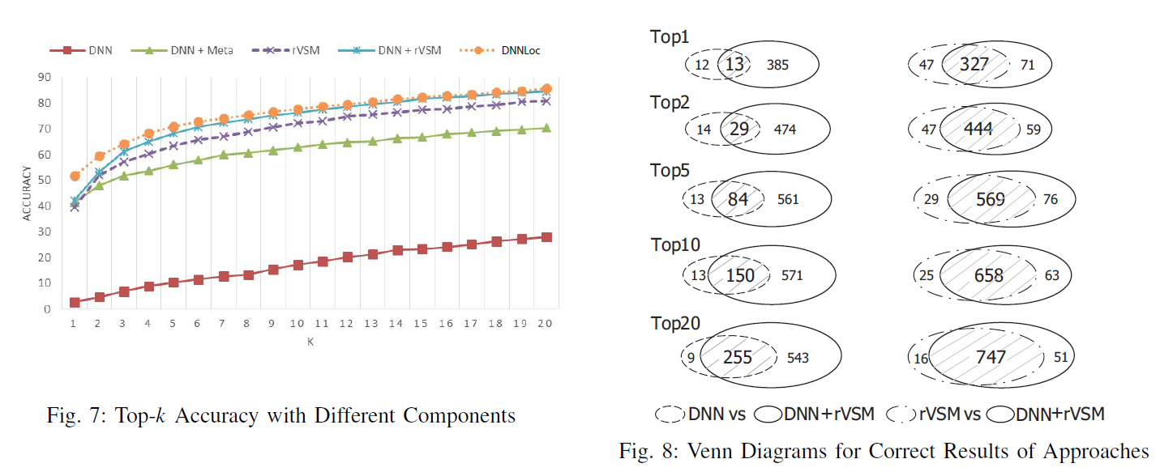
Empirical evaluation (2)
Comparison among proposed DNNLOC’s components

Slide 20
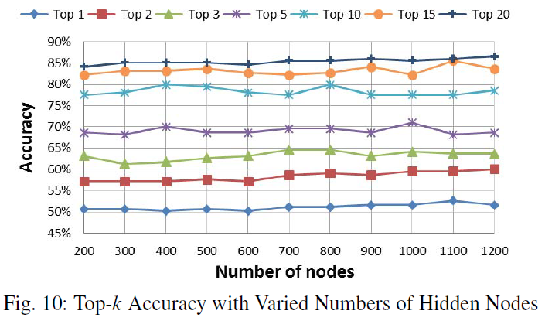
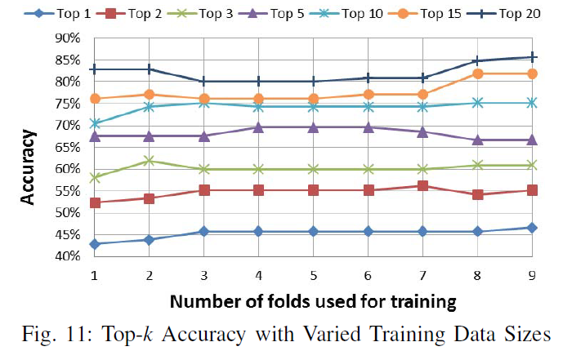
Empirical evaluation (3)
Accuracy comparison on the number of nodes in the hidden layer, Training data size

Slide 21
Empirical evaluation (4)
Accuracy & comparison with existing approaches
B : set of all bug reports
K : set of positions off buggy files in the ranked list
Index_{i} = index of the highest ranked actual buggy file
T_{testset} : number of cases
MAP, MRR are between 0 and 1, higher better

Slide 22
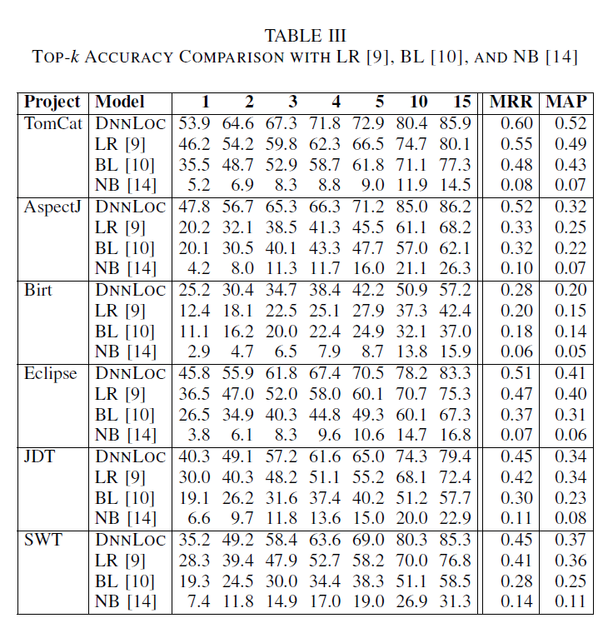
Empirical evaluation (5)

Slide 23
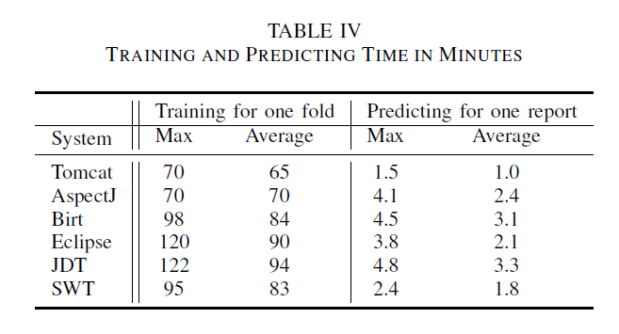
Empirical evaluation (6)
Time efficiency analysis
CPU: Intel Xeon CPU E5-2650 2.00GHz(32cores), 126GB RAM

Slide 24
Conclusion
Combined rVSM and DNN
Used another DNN to ensemble two models result with meta data at the same time
rVSM and DNN well complement
Higher accuracy than state-of-the-art rVSM and DNN respectively

