Slide 1
Making Automatic Repair for Large-scale Programs More Efficient Using Weak Recompilation
G2018920004 민경식
Yuhua Qi, Xiaoguang Mao, Yan Lei
National University of Defense Technology Changsha, China
28th IEEE ICSM 2012

Slide 2
▶ 목차
Weak
Recompilation
Experiment & Result
Introduction
WAutoRepair
Conclusion

Slide 3
1 Introduction
In general, the repair process can be divided into three phases
-Locate the program bug
-Generate the candidate patches in light of some specified rules
-Validate these patches through some test cases again and again until a valid patch is found
This paper seeks to reduce the computational cost by optimizing the program recompilation process

Slide 4
1 Introduction(Limitations of Existing Systems)
When a candidate patch is generated, the target program with the application of the patch has to be recompiled and reinstalled to check whether the patch is valid or not
A significant amount of time is spent in recompiling and reinstalling the patched program
For example, time spent in fixing one bug in the php is, on average, 1.84 hours; recompilation of the patched php takes an average of 78.4% of the whole repair time
All of files depending on a modified code fragment, even all the source files, in extreme cases, are recompiled

Slide 5
1 Introduction(Limitations of Existing Systems)
Since programmers are always competent, the program developed by them are very close to the correct version
Thus, it is reasonable to assume that most faults are merely simple ones, and can be fixed by some small syntactical changes
Therefore, there is only minor code difference between each patched program and the original program
Recompiling each patched program completely in strong recompilation technique will suffer from redundant recompilation cost

Slide 6
1 Introduction(Contributions)
Suppose that P is the original program, that c is a component of P (i.e., the program P is assumed to be constructed from a set of components C = {c1, c2,...,cn})
Instead of recompiling all the source files desponding on the modified code fragment, we recompile only the changed component of c’ to a shared library
Then, we use function wrapping, a mechanism provided by an instrumentation tool such as Valgrind, to implement the update to the original program

Slide 7
1 Introduction(Contributions)
We have implemented weak recompilation on C language with our view of components: We define components as the functions included in source code
Benefits are twofold: first, the recompilation time with weak recompilation is suppressed and relatively stable; Second, in weak compilation the reinstallation time is cut down completely
As the original executable program is not regenerated or modified at all, the subsequent reinstallation and reconfiguration are not needed
Notes:
Second : Instead of reinstalling and reconfiguring the recompiled program in order to make the patched program work well in strong recompilation, we can make a patch validly work by loading the shared library produced in weak recompilation, and then implement the update by aid of function wrapping mechanism supported generally by instrumentation tools

Slide 8
1 Introduction(Contributions)
To make a patch work well the original program has to run with some instrumentation tool
But, the instrumentation tool will slow the execution of target program in some extent, making the execution of each test case more time-consuming
The execution cost running with instrumentation tool is not very sensitive to the scale of program
Thus the larger the scale of program, by and large, the better weak recompilation performs

Slide 9
1 Introduction(Contributions)
By combining the weak recompilation technique with Genprog, we have implemented WAutoRepair
In the repair process, with the patched function-level component compiled using regular compilers (such as GCC) to a shared library representing the candidate patch, the original executable program is not modified or regenerated at all
We also evaluated it on three real-world programs: libtiff, php and wireshark with real-life bugs; compared to Genprog

Slide 10
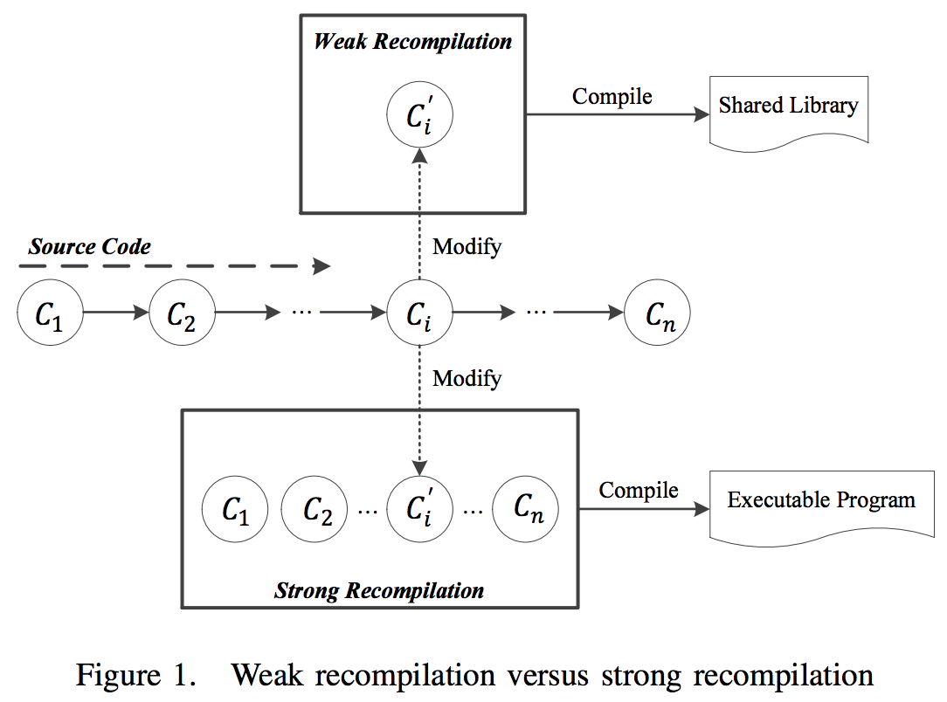
2 Weak Recompilation(Overview)
With existing fault localization technique, the component of $c_{i}$ is located as the defective one causing a failure
$c_{i}$ is modified to repair the program, and thus corresponding $c_{i}$ ‘ is obtained
the $c_{i}$ ‘ component needs only to be compiled to a shared library

Slide 11
2 Weak Recompilation(Program Components)
The C component preliminarily refers to one of three types: function, class and file
Many bugs are merely a few simply program faults which can be fixed by a few trivial changes, and these changes often locate in the same function
We found that all the 55 bugs can be fixed within one function after we reproduced all these experiments on Genprog
Hence, to some extent it is reasonable to limit the the modifiable code scope in one function body

Slide 12
2 Weak Recompilation(Patch)
Patch Description
-A patch produced by weak recompilation includes full code of the $c_{i}$ ‘ component, which will subsequently take the $c_{i}$ ’s place to be called by the original program to check whether the patch is valid or not
Patch Generation
- We have implemented a patch generator, which is based on CIL-1.3.7 in OCaml language to construct patches for C programs in function-level weak recompilation

Slide 13
2 Weak Recompilation(Patch)
Generate the intermediate files from source code (GCC with the flag --save-temps)
Produce a sole file constructed from both the suspicious function and context information
Notes:
1. For most large-scale programs, the recompilation of one function often depends on some context information included in other files

Slide 14
2 Weak Recompilation(Patch)
A
B
Modify the code of the function body in the file generated in the second step
Compile using GCC the changed file to a dynamic patch file in term of a share library
Note that the last two steps can be repeated or iterated to produce more candidate patches

Slide 15
2 Weak Recompilation(Patch)
Patch Application
-Most instrumentation tools such as Valgrind can monitor and control the execution of target program
-With the original program executed with instrumentation tools, we can wrap suspicious function
So the calls to the suspicious function are intercepted and rerouted to the corresponding function included in the shared library produced

Slide 16
3 WAutoRepair (Fault Localization)
Fault Localization: We assume that the defective areas have been already located
What we need to do is just to find the function in which the defective areas locate (suspicious function)

Slide 17
3 WAutoRepair (Patch Generation)
Patch Generation with Genprog : we take the rules used by Genprog to guide the modification process
Notes:
Note that the rules which can be utilized by WAutoRepair are not limited to Genprog, WAutoRepair also works well with other rules

Slide 18
3 WAutoRepair (Executing the Program)
Executing the Program with Valgrind : Valgrind can instrument and monitor both C and C++ programs
Valgrind can automatically complete most works for function wrapping
Then compile the library of wrappers to object code in the normal way
By executing the original program with Valgrind the behaviors of program with the patched function are observed
Notes:
What we need is to generate the wrapper which is represented by a function with a special name which identifies itself as the wrapper for the wrapped function;

Slide 19
3 WAutoRepair (Validation)
Validation : WAutoRepair considers the patch to be valid only if the patched program successfully passes all the test cases
Otherwise WAutoRepair go back to the component of patch generation and continue the search process until some limit is arrived

Slide 20
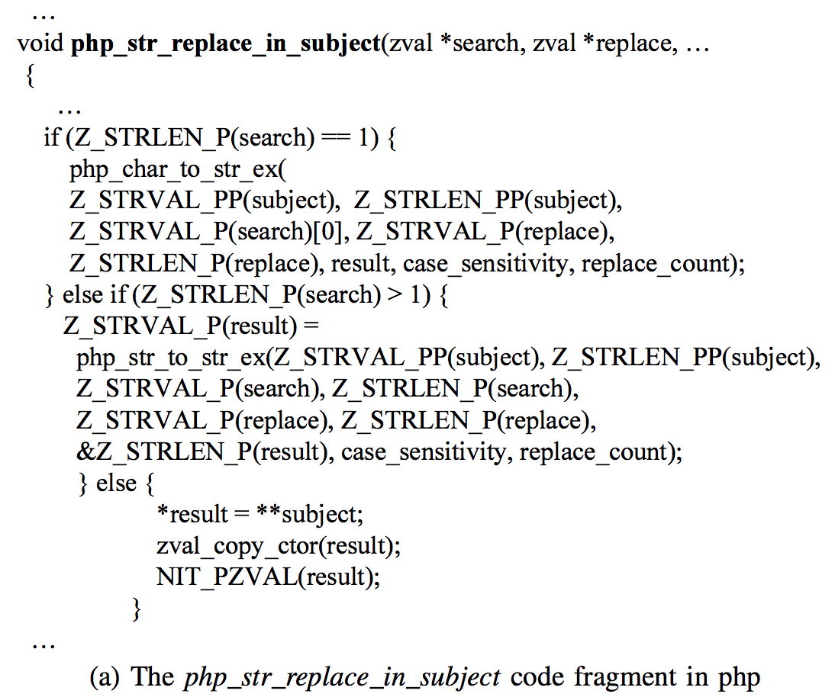
3 WAutoRepair (Case Study)
php_str_replace_in_subject() probably contains a bug and so is considered to be the suspicious function
Analyses source code and produces a intermediate file, which is constructed from both the php_str_replace_in_subject() and relevant context information
Generates one patch at a time by modifying the body code according to the modification rules provided by Genprog

Slide 21
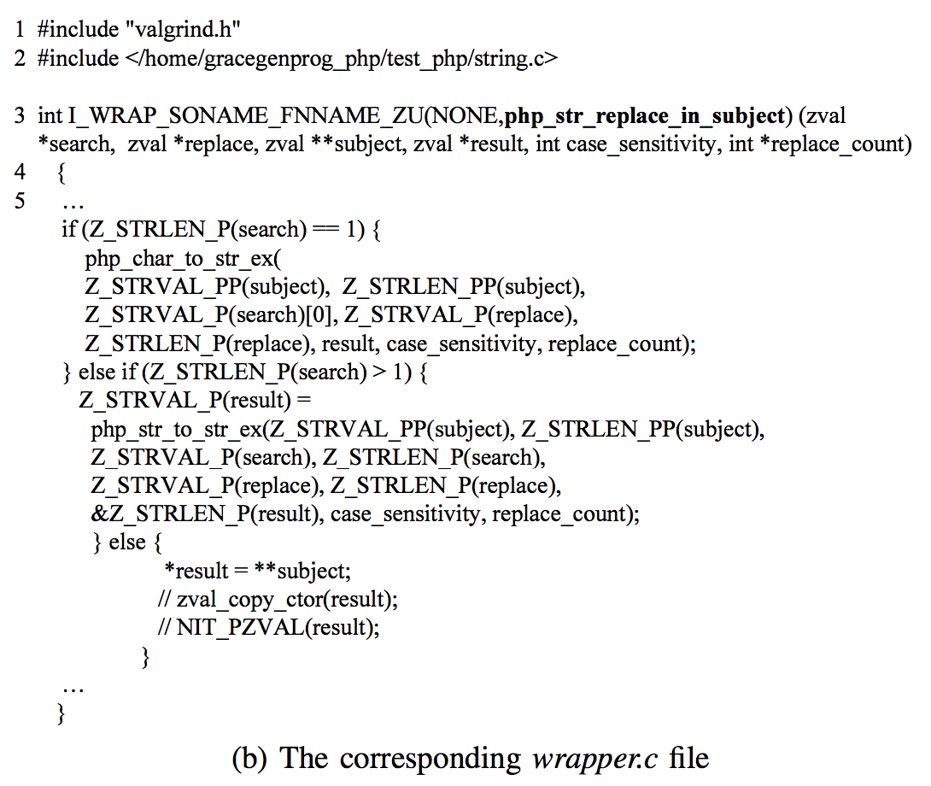
3 WAutoRepair (Case Study)
Macro with the name of I_WRAP_SONAME_FNNAME_ZU (line 3-4) from the included valgrind.h (line 1)
It is an encoded name which Valgrind notices when reading symbol table information
By this, the calls to php_str_replace_in_subject() are automatically intercepted and rerouted to the function encoded by the macro

Slide 22
3 WAutoRepair (Case Study)
The function body (start from line 5) with the candidate patch applied really executed in the subsequent validation process
To ensure that the file can be compiled to a dynamic link library successfully, line 2 includes some relevant context information required by the function body

Slide 23
3 WAutoRepair (Case Study)
Once one candidate patch is produced, WAutoRepair immediately compiles it to a shared library with the file name wrapper.so
Then with wrapper.so loaded, WAutoRepair runs the original php program with Valgrind against test cases in the validation process

Slide 24
4 Experiment & Result(Experimental Setup)
We selected the libtiff, php and wireshark programs with three real bugs
For each bug, we selected one negative test case and three positive test cases, and tried to run WAutoRepair to repair them
WAutoRepair will terminate itself if a valid patch is found, or when some limits are arrived (over 100 trials or 3 hours elapse)

Slide 25
4 Experiment & Result(Experimental Setup)
All the experimental parameters for Genprog in our experiment are the same as those settings all but the weighted path, a sequence of <statement, weight> pairs
In our experiment the weighted path, in which the default weight 1.0 is assigned to each element, is exactly the set of all the statements included in the suspicious function
Namely, the genetic operations of mutation and crossover are constrained to operate only on the suspicious function, and that is consistent with the assumption of weak recompilation

Slide 26
4 Experiment & Result(Results)
The repair effectiveness of WAutoRepair is almost the same as Genprog
Performance Analysis
-In the ”Total” column, WAutoRepair performs obviously better than Genprog,
-With the application of weak recompilation WAutoRepair performs more steady with less compilation cost regardless of the scales of target programs
Notes:
Validating One Candidate Patch” column reports the average time overhead for validating ONE candidate patch, in terms of ”Compilation” (the average time spent in compilation for each successful trial), ”Positive test cases” and ”Negative test case” (the average time taken for the execution of test cases in a successful trial), ”Sum” (the whole time overhead to validate one patch for each repair); the ”Others” column gives the average time overhead spent on the other parts such as the modification to generate each successful patch

Slide 27
4 Experiment & Result(Results)
Effectiveness of Weak Recompilation
-Strong recompilation overhead is correlated with both the scale of target program and the number of files depending on the defective code
-The larger the program scale or the more files depending on the defective code, the more effectiveness of weak recompilation

Slide 28
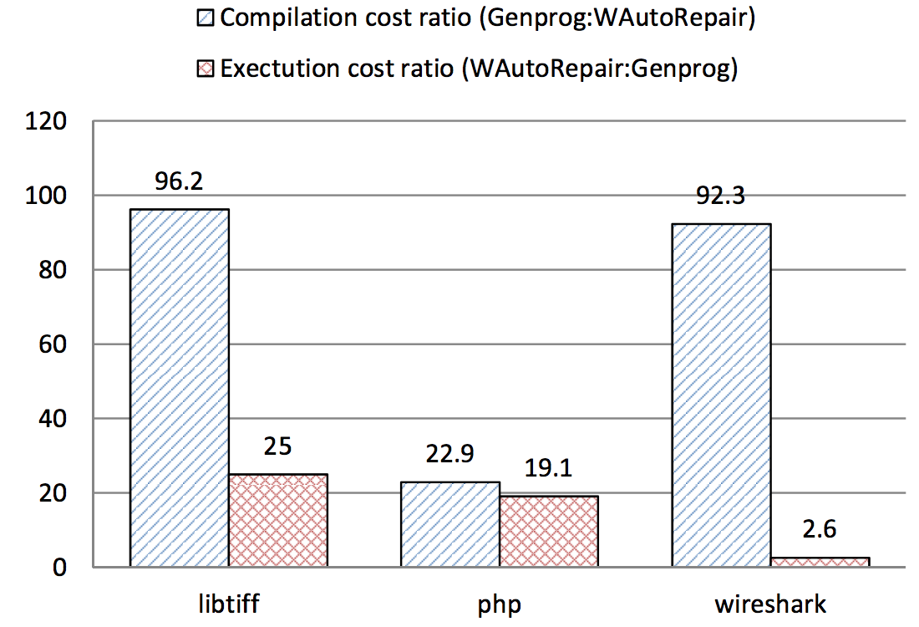
4 Experiment & Result(Results)
Instrumentation Overhead
-The exception is caused by the mechanism of memory leak detection through the analysis to the repair process of wireshark
-Because the execution cost of negative test cases is susceptible to bugs, so we selected the execution cost of positive test cases for compare
-we can increase the number of test cases to guarantee that the obtained patch is actually valid with high confidence level with random sampling technique
Notes:
WAutoRepair can alleviate the extra execution overhead with the application of sampling technique [9], which first evaluates the patched program on a random sample of test cases before the evaluation on the total test cases

Slide 29
4 Experiment & Result(Threats to Validity)
Since only 3 programs are investigated, conclusions drawn from the experimental results are weak and hardly generalizable
We plan to strengthen the conclusions through more experiments on many programs in the future work
If the test cases selected to validate the candidate patch is long-running, the advantage of WAutoRepair may be not very evident
We can use the checkpoint tool to suppress the long-running execution cost
Notes:
Application checkpoint-restart is the ability to save the state of a running application so that it can later resume its execution from the time of the checkpoint.

Slide 30
5 Conclusion
To address expensive compilation cost problem in automated program repair, we present the weak recompilation technique
WAutoRepair is effective in reducing the redundant compilation cost, and outperforms the original Genprog
To our knowledge, for automated program repair we are the first to present and try to address the problem of expensive recompilation cost for large-scale programs
That is, more candidate patches can be validated within a limited time bound. Thus it is possible that more complex modification rules can be adopted to repair defective programs

Slide 31
5 Related Works(Cost Reduction Techniques for Mutation Testing)
Mutation testing also needs to recompile the modified source code for evaluating the effectiveness of a test set in terms of its ability to detect faults

Slide 32
5 Related Works(Weak Mutation)
Program P is also divided into lots of components
The program is terminated immediately after the execution of the $c_{i}$ component
The mutant is killed by comparing the program state of the mutant program with the original program state on the same test case.
However, there is a risk that some valid patches may be taken for invalid ones, leading to false negative

Slide 33
5 Related Works(Compiler-Integrated Technique)
In mutation testing, the mutant is almost the same as the original program but with merely a minor difference
To suppress the redundant compilation cost, there is an method to integrate support for program mutation directly into a compiler
The compiler produces two outputs: a target executable program and a collection of additional machine instruction sequences
And each patch can be applied to the target executable program to yield a patched program without recompilation
However, with the technique the compiler has to be modified

