Slide 1
Automatic Error Elimination by Horizontal Code Transfer Across Multiple Applications
Stelios Sidiroglou-Douskos, Eric Lahtinen, Fan Long, Martin Rinard
MIT CSAIL
Source: ACM PLDI
G201892008 처그

Slide 2
Context
Abstract
Introduction
Usage Scenarios
Contribution
Example
Design and Implements
Experimental Result
Conslusion

Slide 3
Abstract
Code Phage(CP), a system for automatically transferring correct code from donor applications into recipient applications that process the same inputs to successfully eliminate errors in the recipients.
CP to transfer code across applications to eliminate out of bounds access, integer overflow, and divide by zero errors.
CP works with binary donors with no need for source code or symbolic information, it supports wide range use cases.

Slide 4
1. Introduction
1.1 The Code Phage (CP) Code Transfer System
Code Phage (CP) that automatically eliminate errors in recipient software applications by finding correct code from the donor in to recipient.
Donor Selection: CP starts with an application and two inputs: input that triggers error and seed input that doesn’t trigger the error. Working with database of application that can read these inputs, it locates a donor that processes both inputs successfully. The hypothesis is that the donor contains a check, missing in recipient, that enables it to process error triggering input correctly.

Slide 5
1. Introduction
Candidate Check Discovery: CP analyzes the executed conditional branches that take different directions for the seed and error triggering input. The hypothesis is that if the check eliminates the error, the seed input will pass the check but the error triggering input will fail the check.

Slide 6
1. Introduction
Patch Excision: CP performs an instrumented execution of the donor on the error triggering input to obtain a symbolic expression tree that expresses the check as a function of the input fields that determine its value. This execution translates the check from the data structures and name space of the donor into an application independent representation suitable for insertion into another application.

Slide 7
1. Introduction
Patch Insertion: CP next uses an instrumented execution of the recipient on the seed input to find candidate insertion points at which all of the input fields in the excised check are available as recipient program expressions. At each such point, it is possible to translate the check from the application independent representation into the data structures and name space of the recipient.
This translation, in effect, inserts the excised check in to the recipient.

Slide 8
1. Introduction
Patch Validation: CP inserts the translated check in to the recipient at each candidate insertion point in turn, then attempts to validate patch.
Retry: If the validation fails, CP tries other candidate insertion points, other candidate checks, and other donors.
If the transferred check detects an input that may trigger the error, it exits the application before error occur.

Slide 9
1.2 Usage Scenarios
Proprietary Donors:
The CP donor analysis operates directly on stripped binaries with no need for source code or symbolic information. CP can use arbitrary binaries, including closed-source proprietary binaries, as donors for other applications.

Slide 10
1.2 Usage Scenarios
Multilingual Code Transfer:
CP supports multilingual code transfer between applications written different programing languages. Because CP works with binary donors, the current CP implementation generates source level patches in C. It would be straightforward to extend CP to generate patches in other languages.

Slide 11
1.2 Usage Scenarios
Multiversion Code Transfer:
In addition to transferring checks between independently developed applications, we have also used CP to transfer checks between different versions of the same applications.
The motivation is to automatically obtain targeted update that eliminates an error in an older version without the disruption often associated with full upgrade[22].

Slide 12
1.2 Usage Scenarios
Divergent Functionality:
Even though CP works with applications that process the same inputs, the recipient and donor don’t need to the implement same functionality. Many errors occur code that parses the input, constructs the internal data structures that hold the input, and/or reads the input into those data structures. Even when applications have different goals and functionality, the fact that they both read the same input is often enough to enable a successful transfer.

Slide 13
1.2 Usage Scenarios
Continuous Multiple Application Improvement:
CP can work with any source of seed and error triggering inputs. Its current integration with the DIODE automatic error discovery system[55] points the way the future system that combine 1) large libraries of applications, 2) variety of automatic error discovery tools (DIODE, BuzzFuzz[25]), and 3) CP along with other automatic error repair tools such as ClearView[48], staged program repair[37], automatic code fracture and recombination.
Continuously running the error discovery tools across the library of applications, then using horizontal code transfer and other program repair mechanisms to generate repairs delivers an automatic application improvement system that productively leverages the entire global software development enterprice.

Slide 14
Contributions
Basic Concept:
CP automatically eliminates software errors by identifying and transferring correct code from donor applications into incorrect recipient applications. In this way CP can automatically harness the combined knowledge and labor invested across multiple software systems to improve each application.

Slide 15
Contributions
Name translation:
One of the major challenges in code transfer is translating the name of values from the name space of the donor into the name space of recipient. CP shows how use instrumented executions of the donor and recipient meet this name translations.

Slide 16
Contributions
Data Structure Translation:
Another major code transfer challenge is translating between different data representations. CP shows how to use instrumented executions and data structure traversals to meet this challenge.

Slide 17
Contributions
Donor Code Identification:
It presents a mechanism to identity correct code in donor applications for transfer into recipient applications. CP uses two instrumented executions of the donor to automatically identify the correct code to transfer into the recipient (seed input and error-triggering input). A comparison of the paths that these two inputs take through the donor enables CP to isolate a single check (present in the donor but missing in the recipient) that eliminates the error.

Slide 18
Contributions
Insertion Point Identification:
CP automatically identifies appropriate check insertion points within the recipient at which 1) the values needed to express the transferred check computation are available as valid program expressions in the name space of the recipient and 2) transferred check will not affect observed computation unrelated to the error.

Slide 19
Contributions
Experimental Result:
We present experimental result that characterize the ability of CP to eliminate ten otherwise fatal errors in seven recipient applications by transferring correct code from seven donor applications. For all of the 10 possible donor/recipient pairs, CP was able to obtain a successful validated transfer that eliminated error.

Slide 20
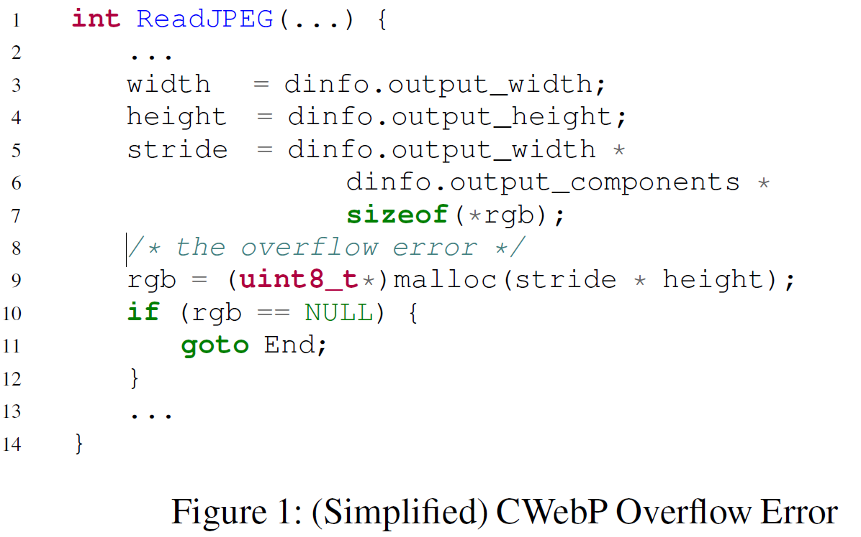
Example
Figure 1 presents (simplified) CWebP source code that contains an integer overflow error. On a 32-bit machine, inputs with large width and height fields can cause the image buffer size calculation at line 9 to overflow. In this case CWebP allocates an image buffer that is smaller than required and eventually writes beyond the end of the allocated buffer.

Slide 21
Example
Error Discovery:
CP works with seed and error triggering inputs identified by the DIODE integer-overflow discovery tool, which performs a directed search on the input space to discover inputs that trigger integer flow errors a memory allocation sites [55]. In our example, the JPG height field is 62848 and width field is 23200.

Slide 22
Example
Donor Selection:
CP next searches a database of applications that process JPG files to find candidate donor applications that successfully process both the seed and error triggering inputs. In our example, CP determines that the FEH image viewer application processes both inputs successfully.

Slide 23
Example
Candidate Check Discovery:
CP next runs an instrumented version of the FEH donor application on the two inputs. At each conditional branch that is influenced by the relevant input field values (in this case the JPG height and width fields), it records the direction taken at the branch and a symbolic expressions for the value of the branch condition.
FEH branch conditions implements a check designed to detect error triggering input.
The seed input and error triggering inputs take different directions at this branch (because error triggering input would satisfy the check and the seed input would not).

Slide 24
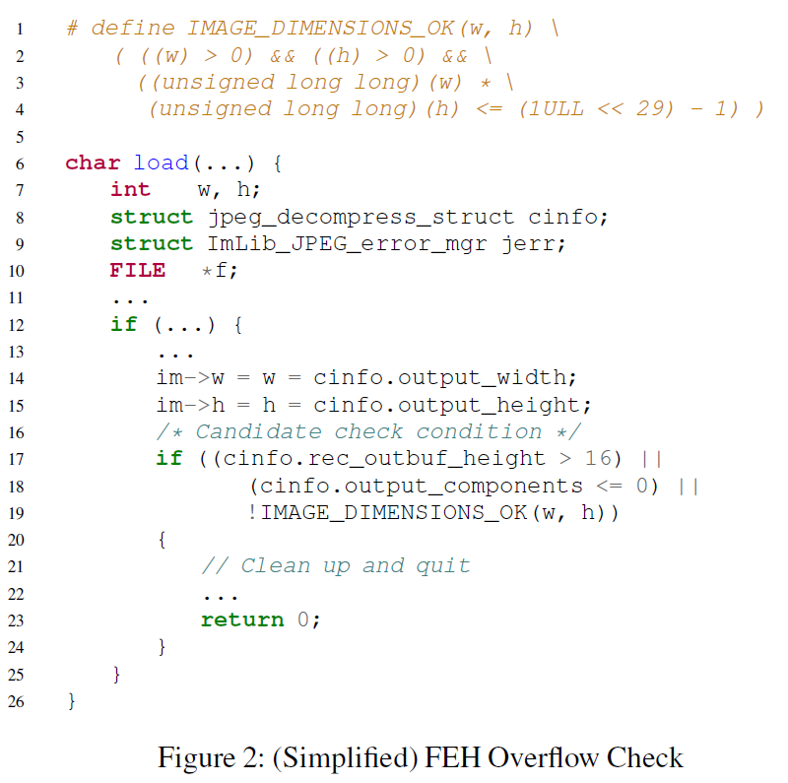
Example
In our example, CP discovers a candidate check in the imlib library that FEH uses to load and process JPG files. The macro IMAGE_DIMENSIONS_OK (defined on lines 1-4, invoked on line 19), performs an overflow check on the computation of output_width * output_height. This check enables FEH to detect and correctly process the error-triggering input without overflow
CP operates on binaries, information about the source code the donor patch is, in general, not available. So that we can present the FEH source code for the check in our example, we used the symbolic debugging information in FEH to manually locate the source code for the check

Slide 25
Example
Candidate check excision:
The FEH checks is expressed in terms of the FEH data structures. The next step is to translate the check from this form into an application-independent form that expresses the check as a function of the input bytes that that determine its value. This translation uses an instrumented execution of the donor to dynamically track the flow of input bytes through program. CP uses this instrumentation to obtain symbolic expressions, in terms of the input bytes, for relevant expressions that the application computes.

Slide 26
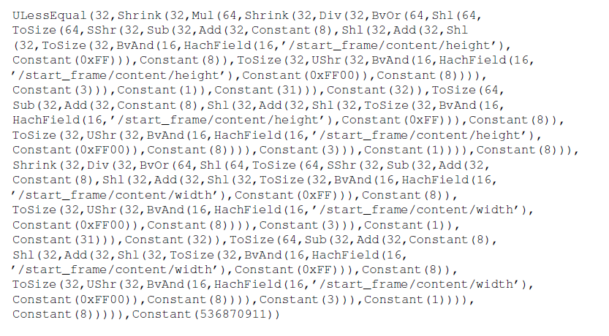
Example
In our example, the translated application-independent symbolic expression for the check is:

Slide 27
Example
There are two primary reasons for the complexity of this excised check. First, it correctly captures how FEH manipulates the input fields to convert from big-endian (in the input file) to little-endian (in the FEH application) representation. The excised check correctly captures the shifts and masks that are performed as part of this conversion. Second, FEH casts 16-bit input field to unsigned long long integers before it performs the overflow check. The excised check properly reflects these operand length manipulations.

Slide 28
Example
Patch Transfer:
The next step is to insert the check into the recipient CWebP application. There are two related challenges: 1) finding a successful insertion point for the check and 2) translating check from the application-independent representation in to the data representation of the recipient CWebP application.

Slide 29
Example
Candidate Patch Insertion Point Identification:
CP runs CWebP (the recipient) on the seed input. CP identifies program points at which the function has read all of the input fields as potential patch insertion point.
In our example, CP recognizes that the ReadJPEG has read both the input JPG width and height fields after line 4 in Figure 1. It therefore identifies the point after this statement as a candidate insertion point.

Slide 30
Unstable Point.
May execute with different values when invoked from different parts of the computation.
To minimize the risk that the inserted check may affect a computation not related to the error, CP filters out all points that access different values on different execution (we call these points unstable points).
The goal is choose the insertion point so that the patch performs the check only when it is relevant to the error.

Slide 31
Example
Multiple Patch Insertion Points:
For CWebP, CP identifies 38 candidate insertion points. 2 of these points are unstable – in some executions of the point, generated expressions reference values other than the desired JPEG width and height input fields. To avoid perturbing computations not related to the error, CP filters out these unstable points. CP then sorts the remaining generated patches by size and attempts to validate the patches in that order. In or example the above patch is the first patch that CP tries (and this patch validates).

Slide 32
Example
Patch Translation:
To translate the patch into the recipient, CP first finds the relevant input fields as stored in the variables and data structures of the recipient. It then determines how to use these fields to express the check.

Slide 33
Example
CP uses the debugging information from the recipient binary to identify the local and global variables available at that candidate insertion point.
Using these variables as roots, it traverses the data structures to find memory locations that store relevant input fields or values.
This traversal is also records expression that evaluate to each of the input fields or input field expressions.

Slide 34
Example
The next step is to use extracted recipient expressions to express the extracted check in the name space of the recipient
CP uses SMT solver to determine this equivalence.

Slide 35
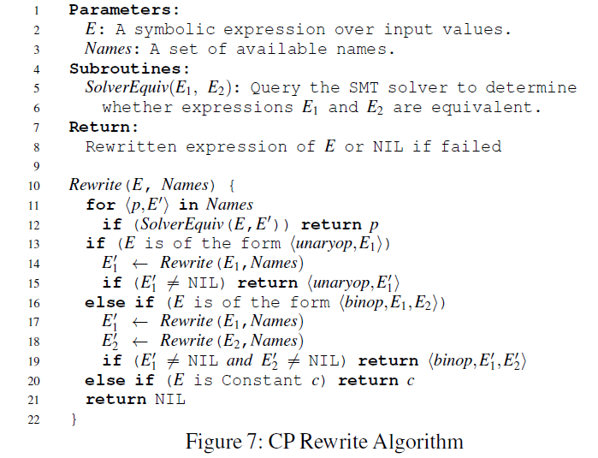
Design and Implementation
The algorithm takes as input a symbolic expression E and set of names Names to translate E to use the available variables and data structures at the candidate insertion point in the recipient. E may take one of four possible forms:
- an input field
- a constant c
- a unary operation expression (unaryop, E)
- A binary operation expression (binop, E1, E2)

Slide 36
Example
In our example, CP produces the following translated check, which it inserts after line 4 in Figure 1:
The generated patch evaluates the check and, if the input fails the check, exits application. The rationale is to exit the application before the integer overflow can occur.

Slide 37
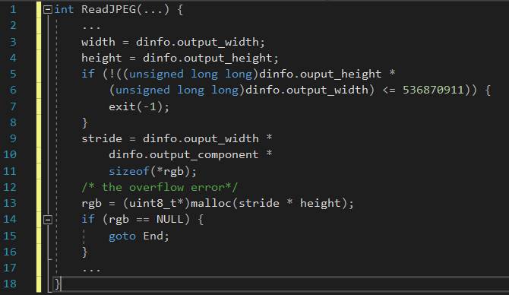
Example

Slide 38
Example
Patch Validation:
Finally, CP rebuilds CWebP, which now includes the generated patch, and subject the patch to a number of tests.
First, it ensures the compilation process finished correctly.
Second, it executes the patched version od CWebP on the error triggering input and checks that the input no longer triggers the error.
Third, it runs a regression test that compares the output of the original application, on regression suite of inputs that the application is known to process correctly.
Fourth, CP runs patched version of the application through the DIODE error discovery tool to determine new error triggering inputs. In our example, DIODE finds no error triggering inputs.

Slide 39
Experimental Result
We evaluate CP on 10 errors in 7 recipient applications.
Jasper 1.9 [11]
Git2tiff 4.0.3 [9]
CWebP 0.31 [1]
Dillo 2.1 [2]
Swplay 0.55 [7]
Display 6.52-8 [8]
Wireshark 1.4.14 [14]

Slide 40
Experimental Result
Donor applications
FEH 2.9.3 [3]
mtpaint 3.4 [12]
ViewNoir 1.4 [8]
gnash 0.8.11 [10]
OpenJpeg 1.5.2 [13]
Display 6.5.2-9 [5]
Wireshark 1.8.11 [14]

Slide 41
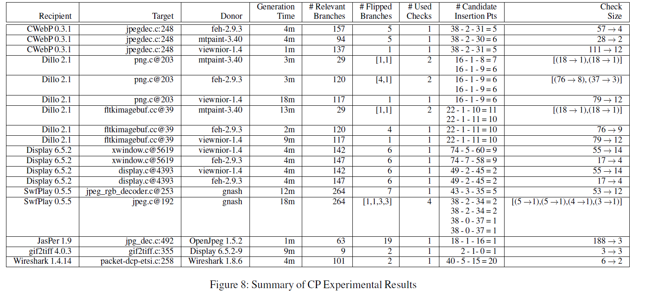
Experimental Result

Slide 42
Experimental Result
Recipient – Recipient application that contains error.
Target – source code file and line where the vulnerability occurs.
Donor – Donor application.
Patch Time – Amount of the time that CP required to generate the patch
Relevant Branches – Number of branches that depend on relevant value.
Flipped Branches – Number of branches that take different directions for the seed and error triggering inputs.
Used Checks – Number of checks that CP transferred to eliminate error.
Candidate Insertion Points – X – Y – Z = W
X – Number of candidate insertion points.
Y – Number of unstable points.
Z – Number of insertion point at which CP was unable to translate the patch.
W – Number of points at which CP is able to insert a successfully translated patch.
Check Size – X -> Y
X – Number of operations in the excised application independent representation of the check.
Y – Number of operations in the translated check as it is inserted into recipient

Slide 43
Conclusion
Our manual evaluation of the patches indicates that
They all completely eliminate the target error
They don’t affect computation unrelated to the error
We present a new and, first technique for automatically transferring code between systems to eliminates errors.
We hope this research will inspire other techniques that identify and combine the best aspects of multiple system.

