Slide 1
R2Fix: Automatically Generating Bug Fixes from Bug Reports
Chen Liu, Jinqiu Yang and Lin Tan University of Waterloo, ON, Canada
Munawar Hafiz Auburn
University, AL, USA
어느 학회인지 추가해야함
G2018920004 민경식

Slide 2
▶ 목차
Bug Fix Patterns
Experiment & Result
Discussion & Conclusion
Introduction
Methodology

Slide 3
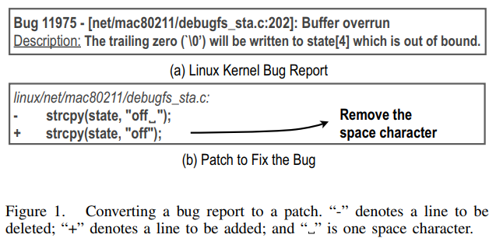
1 Introduction
Upon receiving a bug report, developers diagnose the root cause of the bug, produce a patch that can fix the bug, and commit the patch to the source code repository
We combine the first two steps (diagnosis and patch generation)
Figure 1(a) shows a Linux kernel
buffer overflow/overrun bug report
The result of this challenging and
time-consuming process is
Figure 1(b) patch
Notes:
The developers first need to understand this bug report by reading the relevant code together with this report:
The developers then need to check out the buggy version, modify the buggy code to fix the bug, and generate the patch that can be applied to the shared source code repository.

Slide 4
1 Introduction(Ideal Goal Versus Realistic Goal)
We found that only 16.7–33.5% of bug reports in the Linux kernel, Mozilla, and Apache bug databases are fixed because of invalid bug reports
Even among bugs that can be fixed, some are too complex to be fixed automatically because they require redesign of the algorithm, addition of new features, etc
But many simple bugs have severe impact and any time and effort saving in fixing bugs should be valuable

Slide 5
1 Introduction(Contributions)
As different types of bugs require different types of fixes, R2Fix generates bug fixes by bug type (e.g., buffer overflows, or memory leaks)
R2Fix analyzes bug reports, determines the bug types, and generates patches for developers to verify
To recover missing information, we leverage past bug fix patterns to automatically diagnose bugs and generate fixes
For example, if most buffer overflows are fixed by two common fix patterns, one of the two patches according to the patterns is likely to be a correct patch

Slide 6
1 Introduction(Contributions)
Second, we apply machine learning techniques to automatically identify the root causes from bug reports
We evaluate R2Fix on three large and popular software projects—the Linux kernel, Mozilla, and Apache—for three important types of bugs: buffer overflows, null pointer bugs, and memory leaks.
For bug reports that R2Fix can generate patches for, we compare the patches with developer generated patches if they can be identified

Slide 7
2 Bug Fix Patterns
Reason1 : bug fix patterns affect the feasibility and applicability of automatic patch generation based on the common fix patterns from bug reports
Reason2 : fix patterns can recover diagnostic information missing from a bug report because they are learned from past developer-generated patches
We study three important and dominant types of bugs— buffer overflows, null pointer bugs, and memory leaks

Slide 8
2 Bug Fix Patterns(Data Collection)
We only manually read closed fixed bug reports whose fixes can be identified from the reports or the version control systems
we use keywords related to each bug type to collect additional closed fixed bug reports(e.g “buffer”, “overflow”)
In total, we collect 51 buffer overflows, 91 null pointer bugs, and 41 memory leaks

Slide 9
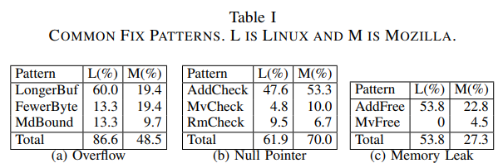
2 Bug Fix Patterns(Fix Pattern Study Results)
Table I shows that many bugs are fixed by a few simple fix patterns and the fix patterns for the same type of bugs are the same in different software
Leveraging these fix patterns to automatically generate patches from bug reports
Reusing the fix patterns to automatically generate patches for other software
Notes:
(a) allocating a longer buffer (LongerBuf), assigning fewer bytes to a buffer (FewerByte), and modifying the bounds check conditions (MdBound)
(b) adding a null check before dereferencing the pointer (AddCheck), moving the null check before dereferencing the pointer (MvCheck), and removing unnecessary null checks (RmCheck)
(c) adding code to free memory (AddFree) and moving the memory releasing code so that it frees the memory in all paths (MvFree)

Slide 10
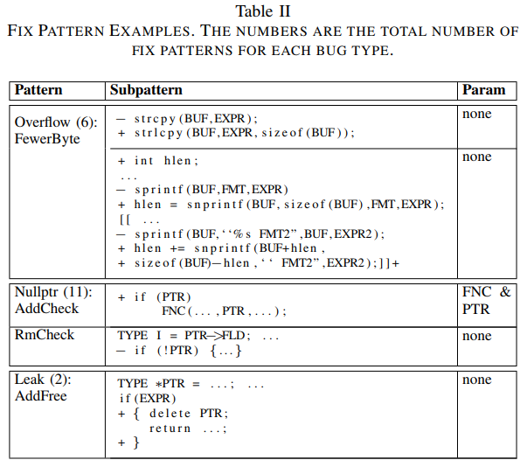
2 Bug Fix Patterns(Fix Pattern Study Results)

Slide 11
2 Bug Fix Patterns(Fix Pattern Study Results)
To use these fix patterns for patch generation, we need to know the pattern parameters, such as the pointer name, so that we know for which pointer we need to add a null check
Therefore, each fix pattern is shown with the pattern parameters required (column “Param”)
Other uppercase names represent what is extracted from the code during the fix pattern matching process
Notes:
‘TYPE’ matches a valid type; ‘EXPR’ and ‘EXPR2’ match valid source code expressions; ‘BUF’, ‘I’, ‘PTR’, ‘FLD’, and ‘FNC’ match identifiers; and ‘FMT’ and ‘FMT2’ are format strings. ‘[[]]+’ indicates the content should repeat one or more times.

Slide 12
3 Methodology(R2FIX OVERVIEW)
R2Fix analyzes the bug report, determines the bug type, and generates possible patches to fix the bug
R2Fix diagnoses a bug report by narrowing down to one or two relevant patches
For example, the second FewerByte subpattern does not generate a patch for the bug report in Figure 1(a) because R2Fix automatically detects that the relevant source code does not contain a call to sprintf
R2Fix generates on average 1.33 patches per bug report

Slide 13
3 Methodology(R2FIX OVERVIEW)
Bug Classifiers parse and classify bug reports according to the target bug types, and retains only bug reports that are classified as the target bug types, referred to as Candidate Bug Reports
Pattern Parameter Extractor analyzes the candidate bug reports and source code to extract pattern parameters
Patch Generator uses the pattern parameters, the fix patterns for each target bug type, and the source code repository to automatically generate patches

Slide 14
3 Methodology(BUG CLASSIFIERS)
Classifiers are built using a small training set of manually labelled bug reports. We then apply the classifiers on all bug reports to identify candidate bug reports.
One independent classifier is built for each bug type
We use the bag-of-words model to represent the summary and the follow-up reports
We deploy a two-level classification approach, which first determines whether the bug reports describe real bugs
Second level classifier, built from the same bug reports but with labels indicating the specific bug types, classifies the bug reports into target bug types
Notes:
One independent classifier is built for each bug type; therefore, building classifiers for new bug types do not affect the accuracy of the existing classifiers.
A typical bug report contains: a Summary, the Report Submission Time, the Version of the buggy software, the Component, the Priority and Severity, a free-form Initial Report of the bug, and zero to many free-form Follow-up Reports following the Initial Report.
ag of Words 기법은 문서(document)를 자동으로 분류하기 위한 방법중 하나로서, 글에 포함된 단어(word)들의 분포를 보고 이 문서가 어떤 종류의 문서인지를 판단하는 기법을 지칭한다. 예를 들어, 어떤 문서에서 '환율', '주가', '금리' 등의 단어가 많이 나온다면 이 문서는 경제학에 관련된 문서로 분류하고 '역광', '노출', '구도' 등의 단어가 많다면 사진학에 대한 문서로 분류하는 방식이다.

Slide 15
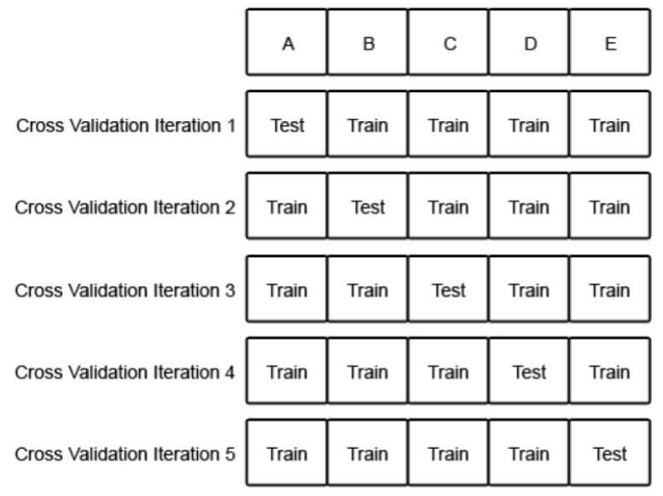
3 Methodology(BUG CLASSIFIERS)
10-fold cross-validation is used to combine bug reports of the same type from all evaluated software to form one training set to build precise classifiers
Bayesian Logistic Regression is used for classifying buffer overflows
Support Vector Machine with a linear kernel is used for null pointer bugs and memory leaks.
We conduct cross-software classification experiments(from Linux kernel and Mozilla, to Apache)
Notes:
K-fold CV(cross-validation) 방법은 데이터 셋을 K개의 sub-set로 분리하는 방법이다. 분리된 K개의 sub-set 중 하나만 제외한 K-1개의 sub-sets를 training set으로 이용하여 K개의 모형 추정한다.

Slide 16
3 Methodology(PATTERN PARAMETER EXTRACTOR)
Extractor extracts generic parameters and bug-type-specific parameters
Generic parameters, required for all bug types, include the file name and the version number of the faulty software
Different types of bugs need different bug-type-specific parameters(Params in Table 2)

Slide 17
3 Methodology(PATTERN PARAMETER EXTRACTOR)
Most of the bug-type-specific parameters are program identifiers, e.g., function names, buffer names
To extract such identifiers, for each word in a bug report, the Extractor searches the word in the source code to see whether it is a function name, a buffer name, etc (by regular expression matching)
If multiple function names and file names are extracted, our Extractor keeps only the first file name and the first two function names

Slide 18
3 Methodology(PATCH GENERATOR)
Patch Generator applies all applicable fix subpatterns for the bug type independently of the target version of the target file
a patch is generated only when an applicable fix pattern can find a match in the target file
Patches generated from multiple fix patterns for the same bug report are independent
Both overflow subpatterns in Table II
are applicable for this bug report
since no pattern parameters are required

Slide 19
3 Methodology(PATCH GENERATOR)
AddCheck subpattern in Table II, require pattern parameters.
Although adding a null check before a pointer dereference is a known way to fix null pointer bugs, it is impractical to add a null check before all pointer dereferences due to the high runtime overhead
Our fix patterns are applied only to a reported bug

Slide 20
3 Methodology(PATCH GENERATOR)
Due to code isomorphisms and the differences in spacing, regular expression based matching is insufficient to identify all equivalent code segments
We leverage a successfully used tool Coccinelle to perform semantic match of the fix patterns.

Slide 21
4 Experiment & Result
We separate open bug reports into open unfixed bug reports and open fixed bug reports
Evaluation measures for patch
Evaluation measures for classification
Notes:
We consider a bug report correctly patched if at least one of the R2Fix-generated patches is identical or semantically equivalent to the developergenerated patch (패치가 동일하게 잘 만들어진 경우)
we can only evaluate the PPrecision on patched bug reports whose developer-generated patches can be found, referred to as verifiable patched bug reports (개발자가 만든 패치가 있는 경우)

Slide 22
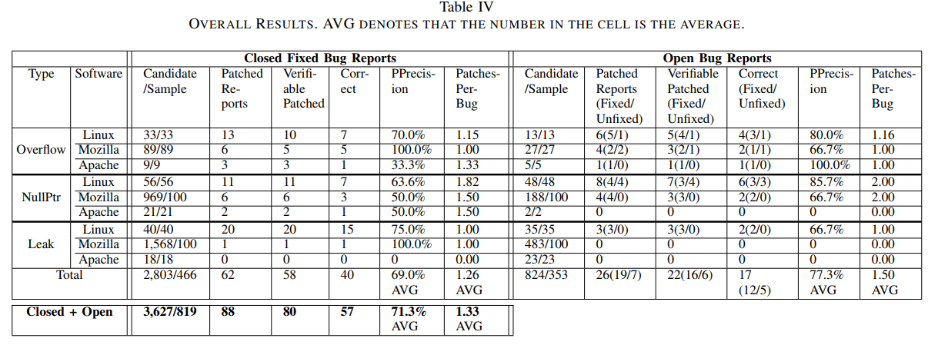
4 Experiment & Result (Patch Generation Results)
Notes:
As thousands of Mozilla bugs are classified as candidate Nullptr and Leak bug reports, we randomly sampled 100 from each to verify the accuracy of R2Fix in patch generation

Slide 23
4 Experiment & Result
57 correct patches, 21 fix potential security vulnerabilities (buffer overflow bugs), including 3 patches fixing confirmed security vulnerabilities in NVD
If R2Fix were applied to these security bugs, their vulnerability window could have been shortened by up to 24 days on average

Slide 24
4 Experiment & Result
Although R2Fix generates correct patches for many bug reports, they constitute a small percentage (<1%) of all closed fixed and open bug reports in the evaluated projects for the following reasons
Evaluating R2Fix on three types of bugs as a proof of concept
We randomly sampled 819 out of the 3,627 candidate reports (22.6%)
R2Fix can only generate patches for a portion of the bugs of the three bug types. Other bug reports do not contain enough information.

Slide 25
4 Experiment & Result
Complex R2Fix-generated patch
the Linux kernel developers accepted the patch and committed it to the kernel git repository
Notes:
one misused sprintf, R2Fix was able to automatically find the missing misuse of sprintf and fix it, which is an advantage of R2Fix over manually generating patches

Slide 26
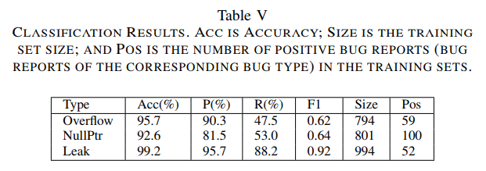
4 Experiment & Result (Classification Results)
Using a relatively small set of manually identified positive bug reports (column “Pos”), R2Fix can discover over thousands of candidate bug reports (column “Candidate” of Table IV)

Slide 27
4 Experiment & Result (Developer Feedback Results)
More than half (4 out of 7) of the developers answered that the R2Fix-generated patches would save their time (Q-1) in (1) understanding the bug and fixing the bug
Almost all (6 out of 7 ) developers answered that they would respond quicker to a bug report with a R2Fix-generated patch attached
Some developers find R2Fix-generated patches could save their time in fixing bugs

Slide 28
5 Discussion & conclusion
Applicability and Generality : Our coarse estimate shows that 17.2% of fixed bug reports in the evaluated projects contain detailed information.
We can add more fix patterns to fix more bugs at the cost of increasing the average number of patches per bug report
Patch Validation : We could not conduct validation experiment because the projects do not have available test cases
R2Fix can generate patches automatically without test cases, while the previous work cannot without test cases

Slide 29
5 Discussion & conclusion
Little Manual Effort Required : If a project uses special functions, such as PR_snprintf for snprintf in Mozilla, the developer needs to supply them to R2Fix
Threats to Validity : The 63 days of average fixing time does not take into account the time for developers to select the correct patch if multiple patches are generated
Certain cosmetic changes may be strongly preferred to follow a certain coding style for a project

Slide 30
5 Discussion & conclusion
R2Fix has generated 57 correct patches with high precision, 5 of which are new patches generated for unfixed bug reports. We reported all 5 new patches, 4 have already been accepted and committed to the code repositories
We build classifiers to automatically identify these types of bug reports, which can be used for other purposes such as evaluating bug detection tools, studying the evolution of certain types of bugs

