Slide 1
Fixing Bugs in Your Sleep: How Genetic Improvement Became an Overnight Success
Saemundur O. Haraldsson, John R. Woodward, Alexander E.I. Brownlee, Kristin Siggeirsdottir GECCO 2017
(presentor: jee-weon Jung)

Slide 2
Contents
Brief overview
Introduction
Related works
Janus manager: Daily activity
Janus manager: Nightly activity
Summary

Slide 3
Brief overview
Describe a self-improving system named Janus manager
Daytime:
Provide overview / control for specialists
Schedule / observe rehabilitation process
Evening:
Self-analysis based on daytime interaction
Generate test data for genetic improvement
Fix bugs
6 months tested

Slide 4
Introduction
Search based software engineering (SBSE)
Use computational search methods → improve existing software
Genetic Improvement (GI)
Use of optimisation and machine learning techniques, particularly search based software engineering techniques such as genetic programming → improve existing software. [Wikipedia]

Slide 5
Introduction
Janus Manager (JM)
Daytime: collect data when user input raises exceptions
Overnight :
Test itself → search adaptions that do not raise exceptions → present the improved options to developers
Significantly decrease the cost of maintenance
Developers have the control
Conduct sanity check before applying

Slide 6
Related work
Generic improvements (GI) are used for non-functional improvements (about 1/3)
Reduce execution time
Bowtie2, CUDA code
Reduce memory consumption
Bug fixing is the largest goal of GI

Slide 7
Janus manager daily activity
Initially started from the need for data management and statistical analysis for rehabilitation service
Developed from (a) to (d)

Slide 8
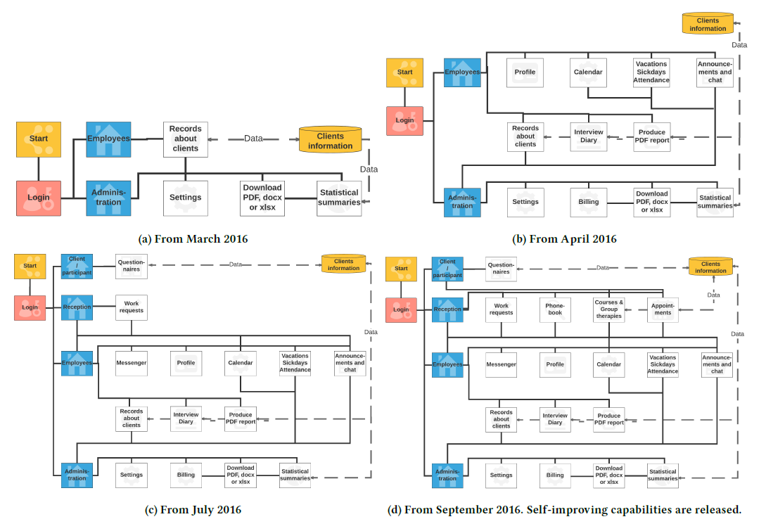
Janus manager daily activity
d

Slide 9
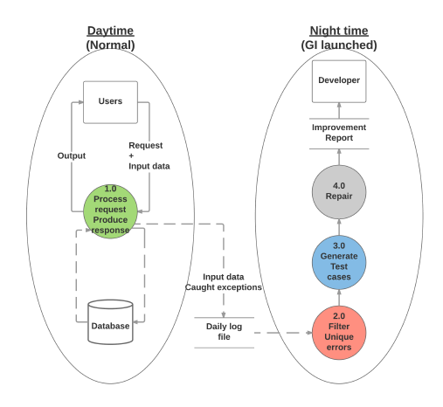
Janus manager daily activity
Users : employees
Specialist & administrator
Request or provide data
Clients: answer questionnaires → specialists use the results to plan treatment / therapy
Input data cause exception → log is left (trace & input data & type of exception )

Slide 10
Janus manager nightly activity
Night process runs until
All reported bugs are fixed
Next morning
During the night..
Analyze logs
Generate test data
Use GI to fix bugs

Slide 11
Janus manager nightly activity -log analysis
Filter exceptions
Obtain a set of unique errors (exception type)
Exceptions can be any subclass of Exception in python
Sorted in order of importance (higher frequency → more important)
Assumes more frequent exceptions are the ones experience by multiple users
Input: defined as the argument list
At every function call

Slide 12
Janus manager nightly activity -generating test data
Conducted with simple random search of neighbourhood of the users’ input data in the log
Input data : represented in python dictionary object
Objective: find various inputs that trigger the same exception

Slide 13
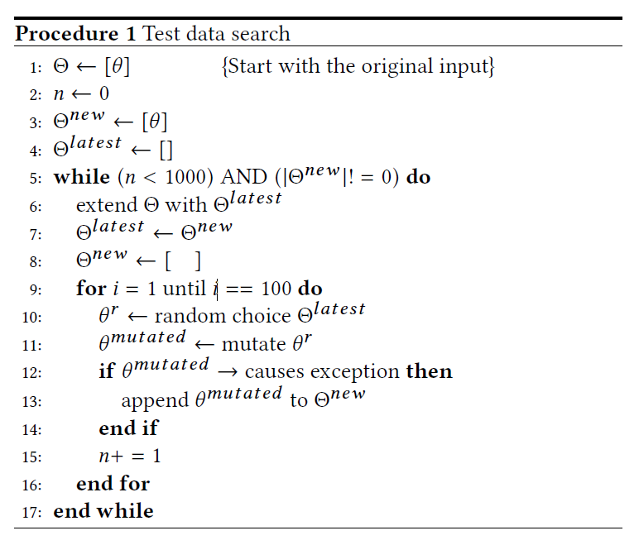
Janus manager nightly activity -generating test data
Make 100 mutations
Single value has been randomly changed
Keep mutations that raise the same exception
ө: original input (the one that raised exception)
Ө: set of inputs

Slide 14
Janus manager nightly activity -generating test data
How to mutate
Change single value
String: randomly add strings from a predefined dictionary
Date: change the format ex) 2017-01-27 → 27-01-17 or randomly pick a date within a year
Time: change the format or randomly pick a time within 24 hours
Integer: add / subtract 1, 2 or 3 (changing scope is arbitrarily chosen)
Float: add a random sample from standard normal distribution N(0, 1)

Slide 15
Janus manager nightly activity -generating test data
Two problems exist in the proposed approach
Do not check whether the generated tests are complementary
Many test cases might deal with the same part of the code
Assumes that no exception → output is correct
Might provide false confidence to developers

Slide 16
Janus manager nightly activity -genetic improvement
Relies on the new test cases & existing test suite
Highest fitness = pass all test cases → functioning correctly
Fitness: proportional to the number of test cases program passes
Operates on the source code directly → no need to convert the program for GI operation

Slide 17
Janus manager nightly activity -genetic improvement
Evolution is population based with 50 solutions in each generation
Evaluated in parallel
Weighted random selection is used for selecting the solution
Weight is determined by the edit list’s proportional fitness w.r.t. the generation’s total fitness

Slide 18
Janus manager nightly activity -genetic improvement
Only half of the population gets selected (=live up to next generation)
Other half is randomly generated again
Prevent early convergence to a local optimum
May also prevent finding solutions that require more than few edits

Slide 19
Janus manager nightly activity -genetic improvement
Single mutation of an edit list is composed of grow / prune / single edit change
Grow: randomly generated edit is appended to the edit list
Prune: remove one edit
Single edit change: single edit is selected and one of its features is randomly changed
GI stops in two conditions
A program variant passes all tests
User arrive to work
Produces an HTML report
List all exceptions encountered, possible fixes

Slide 20
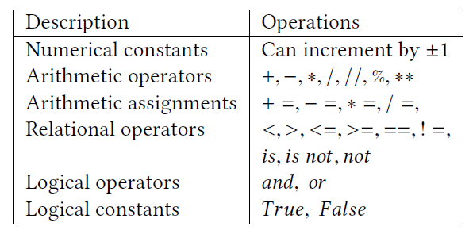
Janus manager nightly activity -generating test data
Available operators to the GI

Slide 21
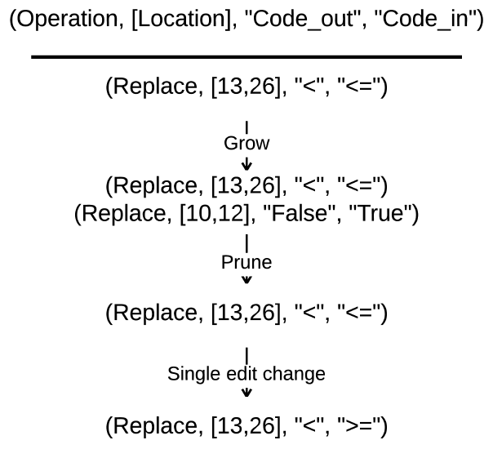
Janus manager nightly activity -generating test data
Example mutation process

Slide 22
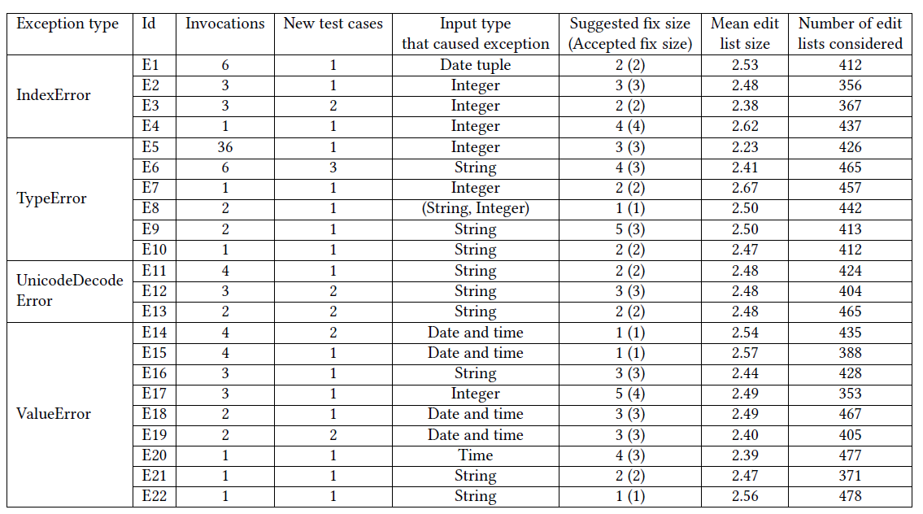
Janus manager nightly activity -generating test data

Slide 23
Summary
Janus manager worked successful
22 bugs were identified and fixed in six months
Halved Janus rehabilitation’s maintenance cost
>>> GI implemented in real world industry
Evolution did not exceed 10 generations (500 evaluated edit list)
>>> can find fixes rather quickly (if exists)

