Slide 1
Using Automated Program Repair for Evaluating the Effectiveness of
Fault Localization Techniques
G2018920004 민경식

Slide 2
▶ 목차
Discussion & Conclusion
Introduction
Background
Approach
Experiment

Slide 3
1 Introduction
Automated fault localization (AFL) techniques are developed to reduce the effort of software debugging
AFL give the programmer suggestions about likely fault locations, such as a suspect list or a small fraction of code
Much existing literature evaluates the effectiveness of AFL from the viewpoint of developers
To quantify the benefits, much existing work evaluates the effectiveness according to the percentage of the program code that needs to be examined before the faults are identified, which is referred to as the EXAM score

Slide 4
1 Introduction(2)
Understanding the root cause of a failure for developers typically involves complex activities
Hence, existing evaluation approaches are not always suitable in practice due to this strong assumption.
In contrast, for fully automated debugging including the program repair of full automation, the activity of AFL is most often necessary
the effectiveness of AFL techniques will be the dominant factor affecting the repair effectiveness when the repair rules have been already specified

Slide 5
1 Introduction(3)
As the first step, we present an evaluation measurement to evaluate the effectiveness of AFL from the viewpoint of fully automated debugging
We refer to the repair effectiveness as the number of candidate patches generated before a valid patch is found in the repair process (NCP score)
Based on NCP, we can justify the advantage of one specified AFL technique by presenting the improved effect size over other techniques through rigorous statistic approach such as A-test

Slide 6
1 Introduction(4)
We used GenProg-FL, a tool which can automatically repair faulty programs like GenProg and have the ability of accepting the guidance of existing AFL techniques
Evaluated the effectiveness of 15 popular AFL techniques by running GenProg-FL to repair 11 real-life programs coming with field failures

Slide 7
2 Background(Automated Fault Localization)
AFL techniques are originally proposed to provide some information to reduce the effort of debugging activity
These techniques can be divided into two categories – statistical approaches and experimental approaches
Statistical approaches, also called spectrum-based approaches, rank each program entity according to their suspiciousness of being faulty by executing test cases
Experimental approaches attempt to narrow down the defective code to a small set of program entity by generating additional executions
Notes:
Both statistical and experimental approaches are developed from the viewpoint of developers

Slide 8
2 Background(The Effectiveness Evaluation of AFL)
Empirical approaches and theoretical approaches were conducted to investigate and evaluate the AFL techniques
Majority of these studies, either through empirical approaches or through theoretical approaches, used the same evaluation measurement of EXAM or its equivalent
Namely, they prefer these AFL techniques that can give the faulty statement higher priority under the assumption of “perfect bug detection”
Which means that examining a faulty statement in isolation is enough for a developer to understand and eliminate the bug
Notes:
it does not normally hold in practice, because understanding the fault causing a failure typically involves many complex activities

Slide 9
2 Background(Automated Program Repair)
Automated program repair, in general, is a three-step procedure: fault localization, patch generation and patch validation.
Suspicious faulty code snippet causing the bug is first identified by AFL techniques
Lots of candidate patches can be produced by modifying that code snippet, according to specific repair rules based on either evolutionary computation or code-based contacts
To check that whether one candidate patch is valid or not, there are two main approaches on assessing patched program correctness: formal specifications and test suits.
Notes:
formal specifications are rarely available despite recent advances in specification mining [18]. Thus, test suits are most often used to validate the patch effectiveness

Slide 10
2 Background(Automated Program Repair)
For automated program repair, the activity of AFL, identifying the program statement(s) responsible for the corresponding fault, is necessary to constrain the fixing operations to operate only on the region of the program that is relevant to the fault

Slide 11
3 Approach(Overview)
The better effectiveness can be referred to as that the fewer invalid patches are produced before a valid patch is found
Since AFL with better effectiveness should have the ability to enhance the repair effectiveness by providing more useful localization information, we can also evaluate the effectiveness of AFL by measuring the corresponding repair effectiveness

Slide 12
3 Approach(Evaluation Framework)
For developers, they center on only the ranking of faulty statements rather than the absolute suspiciousness values
Most existing techniques on automated program repair use randomized algorithms, such as evolutionary computation, to select some statements as the target for modification
List = {(s1, sp1),(s2, sp2), · · · ,(sn, spn)}, 0 ≤ sp ≤ 1

Slide 13
3 Approach(Framework Implementation: GenProg-FL)
GenProgFL has the ability of repairing automatically C programs
GenProg-FL is the modification version of GenProg by adding the interface for accepting the localization information on the fault
It is almost the only state-of-the-art automated repair tool having the ability of fixing real-world, large-scale C faulty programs

Slide 14
3 Approach(Evaluation Measurement)
EXAM evaluates the effectiveness by observing the rank of faulty statements in ranking list produced by AFL
Unfortunately, this evaluation measurement suffers from two problems.
First, finding precisely the faulty statements is often time-consuming or impossible for real-life, complex faults

Slide 15
3 Approach(Evaluation Measurement)
The results of two techniques are equivalent according to the EXAM measurement
Rank1 = {(sj , 1),(sp, 0.9),(s3, 0.8), · · · },
Rank2 = {(sj , 1),(sp, 0.8),(s3, 0.7), · · · }
For instance, suppose that for the same faulty program P with the actually faulty statement of s3,
Although AFL1 produces bigger suspiciousness value of s3, which improves the probability of s3 being selected for modification, the bigger value of sp will also improves the probability of sp being wrongly selected for modification, increasing the risk of introducing unexpected side effect

Slide 16
3 Approach(Evaluation Measurement)
This paper measures the repair effectiveness of GenProg-FL according to the Number of Candidate Patches (NCP) generated before a valid patch is found in the repair process.
The lower NCP score can be observed in the repair process, the better repair effectiveness can be performed by GenProg-FL
the NCP is most probably different for each run of GenProg-FL due to the use of randomized algorithm (i.e., genetic programming)
It uses statistical analysis, including nonparametric Mann-Whitney-Wilcoxon test and A-test, to evaluate and compare various AFL techniques

Slide 17
4 Experiment(Research Questions)
Do the AFL techniques performing well under the evaluation measurement of EXAM still have good performance according to NCP measurement?
Does there exist some AFL technique(s) performing better over other techniques, according to NCP score?
If so, to what extent can the AFL technique(s) perform better on the improvement than other techniques?

Slide 18
4 Experiment(Investigated AFL Techniques)
GenProg-FL requires suspiciousness value sp of each statement must meet the constraint of 0 ≤ sp ≤ 1. Some AFL techniques, however, do not meet the constraint
To ensure that investigated AFL techniques work well with GenProg-FL, we preprocess the output of each AFL technique in a way of normalizing these suspiciousness values
Notes:
For instance, the value of sp in ranking list produced by Wong3 technique can be negative for some statements

Slide 19
4 Experiment(Statistical Analysis)
the nonparametric Mann-Whitney-Wilcoxon test and A-test are separately used to qualitatively and quantitatively analyze the improvement of AFL1 over AFL2
For nonparametric Mann-Whitney-Wilcoxon test, the null hypothesis is that result data from AFL1 and AFL2 share the same distribution; the alternate hypothesis is that the two group data have different distributions.
we say the improvement of AFL1 over AFL2 is statistical significance when we reject the null hypothesis at a 5 percent significance level.

Slide 20
4 Experiment(Statistical Analysis)
We used the nonparametric Vargha-Delaney A-test to evaluate the magnitude of the improvement by measuring effect size(a difference in the localization effectiveness in term of NCP score)
In Vargha and Delaney suggest that A-statistic of greater than 0.64 (or less than 0.36) is indicative of “medium” effect size, and of greater than 0.71 (or less than 0.29) can be indicative of a promising “large” effect size.

Slide 21
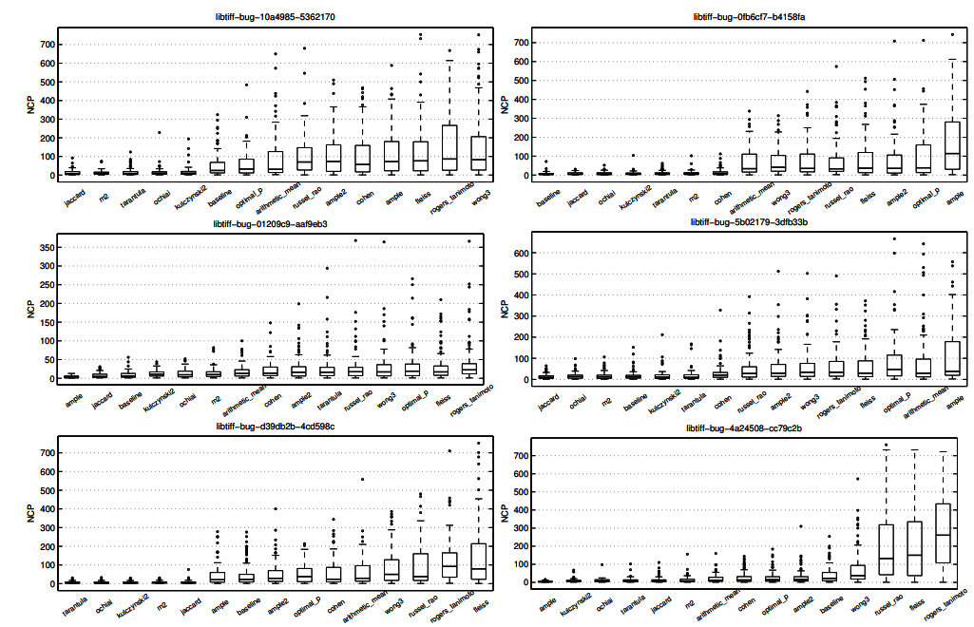
4 Experiment(Result)

Slide 22
4 Experiment(RQ1)
Ochiai performs better than the techniques of Jaccard and Tarantula according to the EXAM measurement
As shown in Figure 1, however, Ochiai did not always perform better over other techniques according to the mean on NCP score
Overall, although more experiments are needed before strong conclusions can be drawn, Figure 1 shows that these AFL techniques performing well under the evaluation measurement of EXAM do not have good performance according to NCP measurement

Slide 23
4 Experiment(RQ2)
Jaccard technique has the better effectiveness over most techniques in term of the smaller mean value.
Table 2 gives the significance information (based on MannWhitney-Wilcoxon test) on the comparisons of Jaccard and the other techniques for each subject programs.
We can observe that for the first 10 subject programs Jaccard significantly has the smaller NCP score than most studied techniques

Slide 24
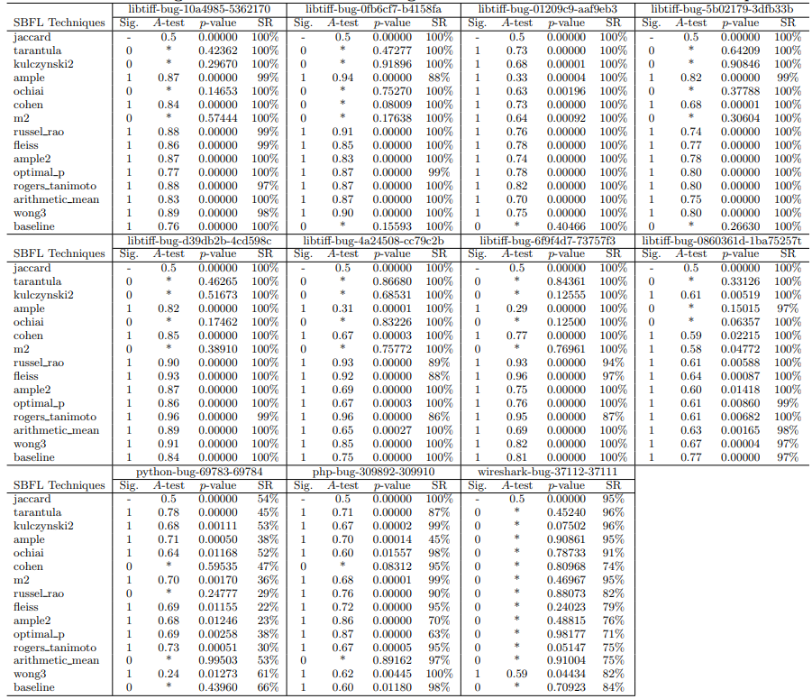
4 Experiment(RQ2)
Notes:
Note that there are a total of 100 repair trials for one AFL technique on each program. Hence, there are n successful trials if the success rate is n%, which is shown in Table 2; the statistics in Figure 1 and Table 2 are computed according to the n successful trials.

Slide 25
4 Experiment(RQ3)
Table 2 quantitatively shows the improvement in term of A-test representing the effect size, if the improvement is statistical significance using Mann-Whitney-Wilcoxon test
For most programs except wireshark, Jaccard most often has the “medium” effect size over other techniques. The effect size can be promising “large” in some cases.

Slide 26
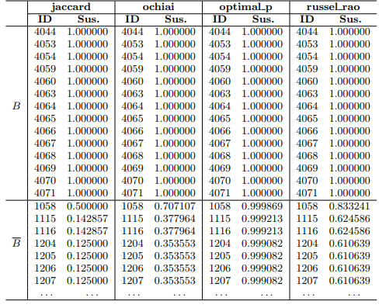
5 Discussion
Jaccard has more sharp score than other techniques which are considered to have the ability of ranking faulty statements higher in prior studies

Slide 27
5 Discussion
Although some techniques may rank faulty statements higher, they also produce not too low suspiciousness of many normal statements
It drastically increases the risk of modifying normal statements in B, resulting in new faults introduced.

Slide 28
5 Conclusions
Existing AFL techniques have been developed with the goal of helping developers fix bugs in code
In contrast, the activity of AFL is most often necessary for the techniques on automated program repair, an indispensable part for the implementation of fully automated debugging
The AFL techniques performing well in prior studies do not have good performance from the viewpoint of fully automated program repair
Jaccard performs at least as good as the other 13 investigated techniques, with the effectiveness improvement up to “large” effect size

Slide 29
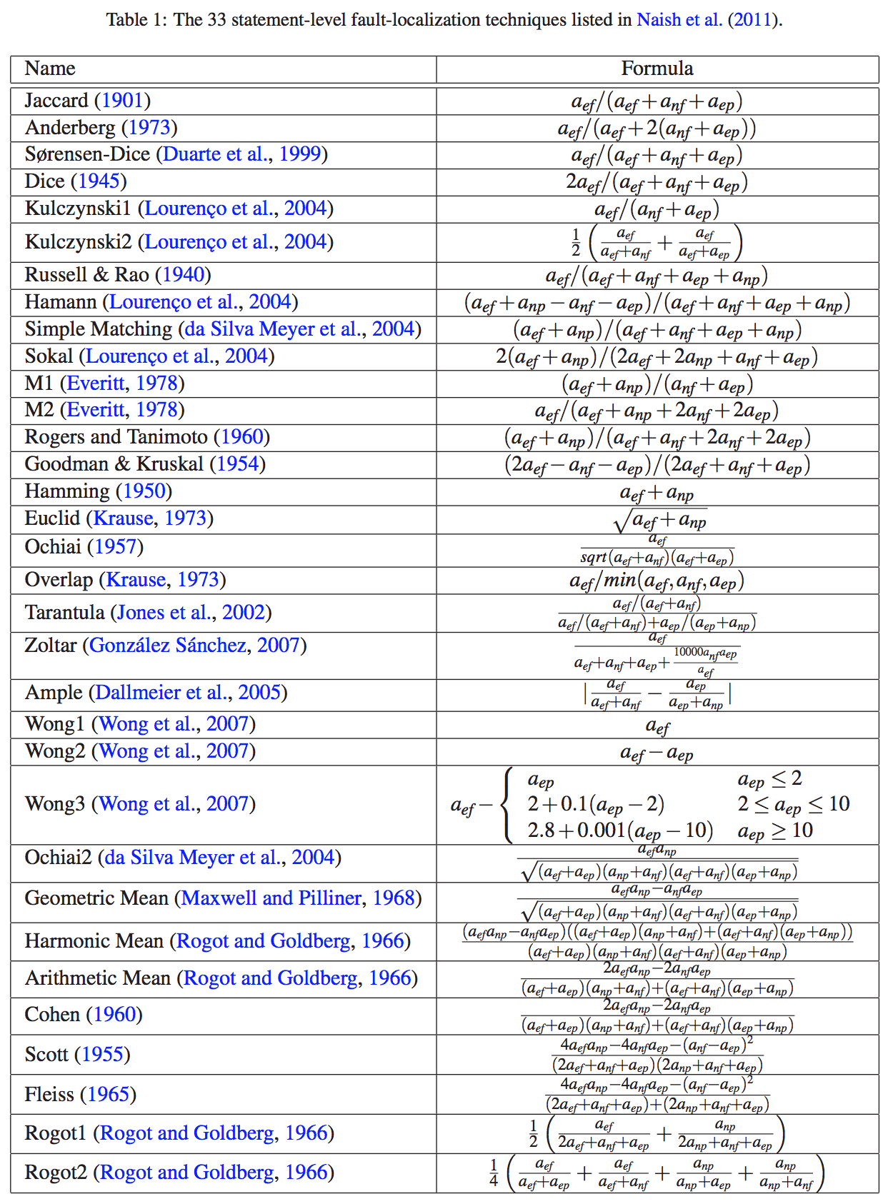
$a_{ef}$=failed
$a_{nf}$=not failed
$a_{ep}$=passed
$a_{np}$=not passed

